Slide 1
Advanced Clipping Algorithms
Prof. Subhadip Basu
Dept. of CSE, JU

Slide 2
Parametric Line Equation
P₀
P₁
Line: P(t) = P₀ +t(P₁-P₀)
t value defines a point on the line going through P₀ and P₁
0 <= t <= 1 defines line segment between P₀ and P₁
P(0) = P₀ P(1) = P₁

Slide 3
The Cyrus-Beck Technique
Cohen-Sutherland algorithm computes (x,y) intersections of the line and clipping edge
Cyrus-Beck finds a value of parameter t for intersections of the line and clipping edges
Simple comparisons used to find actual intersection points
Liang-Barsky optimizes it by examining t values as they are generated to reject some line segments immediately

Slide 4
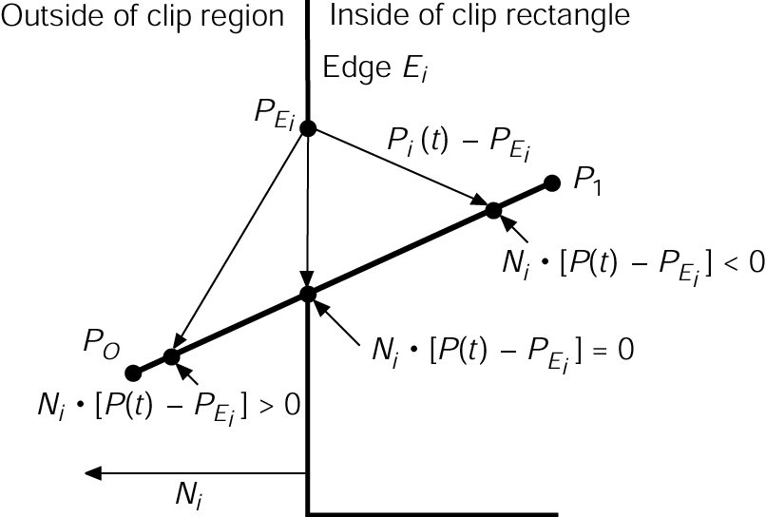
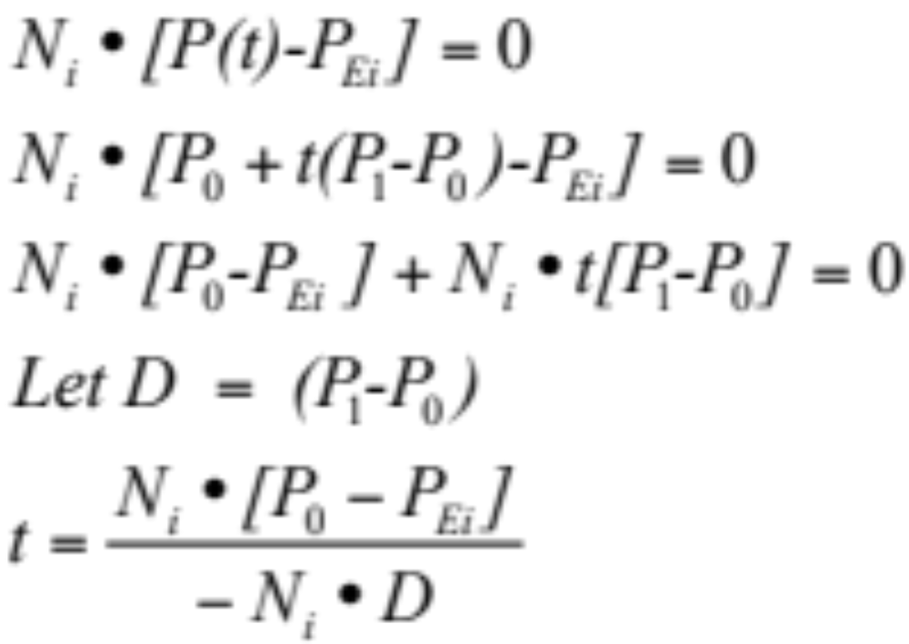
Finding the Intersection Points
Line P(t) = P₀ +t(P₁-P₀)
Point on the edge P_{ei}
N_{i} ➔ Normal to edge i
Make sure
D ≠ 0, or P₁ ≠ P₀
N_{i}• D ≠ 0, lines are not parallel
1994 Foley/VanDam/Finer/Huges/Phillips ICG

Slide 5
Calculating N_{i}
N_{i} for window edges
WT: (0,1) WB: (0, -1) WL: (-1,0) WR: (1,0)
N_{i} for arbitrary edges
Calculate edge direction
  E = (V₁ - V₀) / |V₁ - V₀|
  Be sure to process edges in CCW order
Rotate direction vector -90°
  N_{x} = E_{y}
  N_{y} = -E_{x}

Slide 6
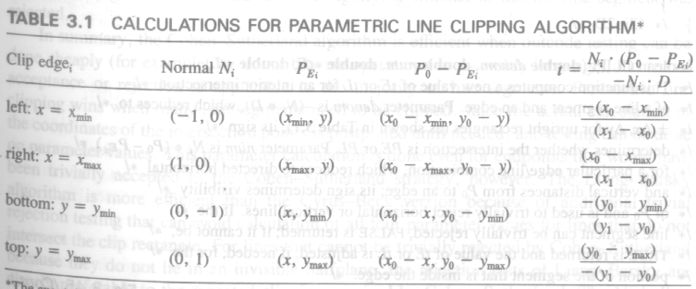

Slide 7
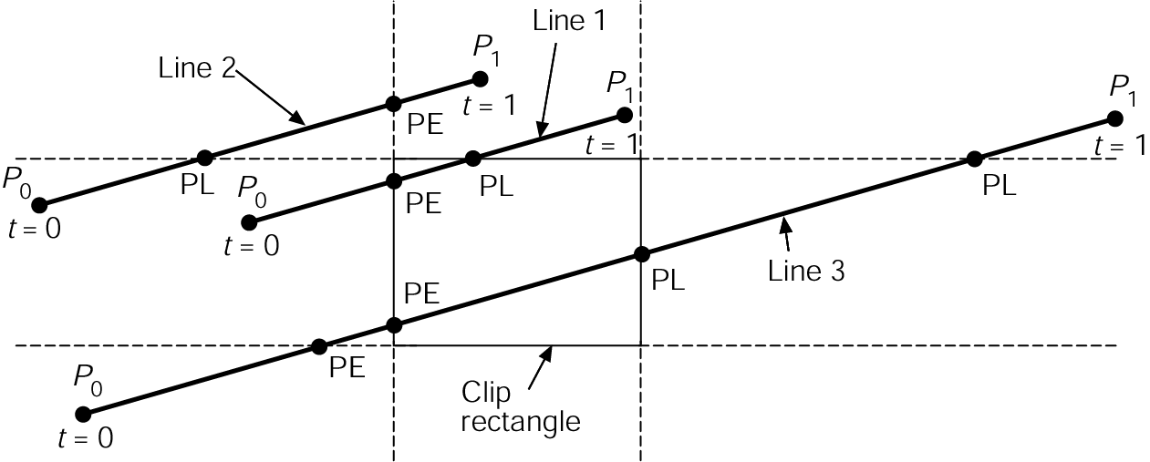
Finding the Line Segment
Calculate intersection points between line and every window line
Classify points as potentially entering (PE) or leaving (PL)
PE if crosses edge into inside half plane => angle P₀ P₁ and N_{i} greater 90° => N_{i}• D < 0
PL otherwise.
Find T_{e} = max(t_{e})
Find T_{l} = min(t_{l})
Discard if T_{e} > T_{l}
If T_{e} < 0, T_{e} = 0
If T_{l} > 1, T_{l} = 1
Use T_{e}, T_{l} to compute intersection coordinates (x_{e},y_{e}), (x_{l},y_{l})
1994 Foley/VanDam/Finer/Huges/Phillips ICG

Slide 8
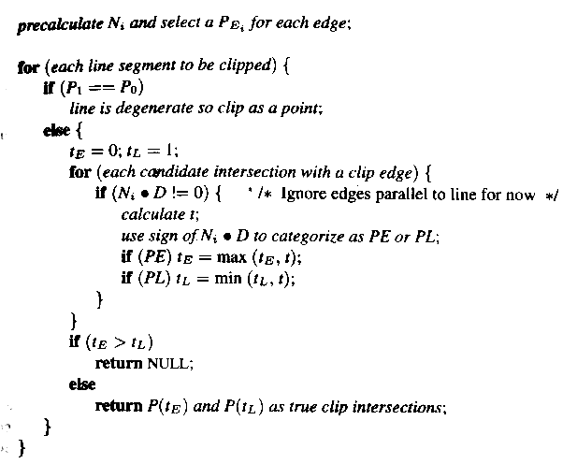
Cyrus-Beck Algorithm
168 471 Computer Graphics, KKU. Lecture 8

Slide 9
Liang-Barsky
Line Clipping
Consider the parametric definition of a line:
  x = x1 + u∆x
  y = y1 + u∆y
  ∆x = (x2 - x1), ∆y = (y2 - y1), 0 ≤ (u) ≤ 1
What if we could find the range for u in which both x and y are inside the viewport?

Slide 10
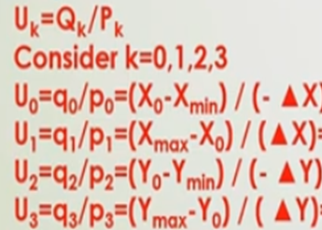
Liang-Barsky
Line Clipping
Mathematically, this means
  xmin ≤ x1 + u∆x ≤ xmax
  ymin ≤ y1 + u∆y ≤ ymax
Rearranging, we get
  -u∆x ≤ (x1 - xmin)
  u∆x ≤ (xmax - x1)
  -u∆y ≤ (y1 - ymin)
  u∆y ≤ (ymax - y1)
  In general: uk * pk ≤ qk

Slide 11
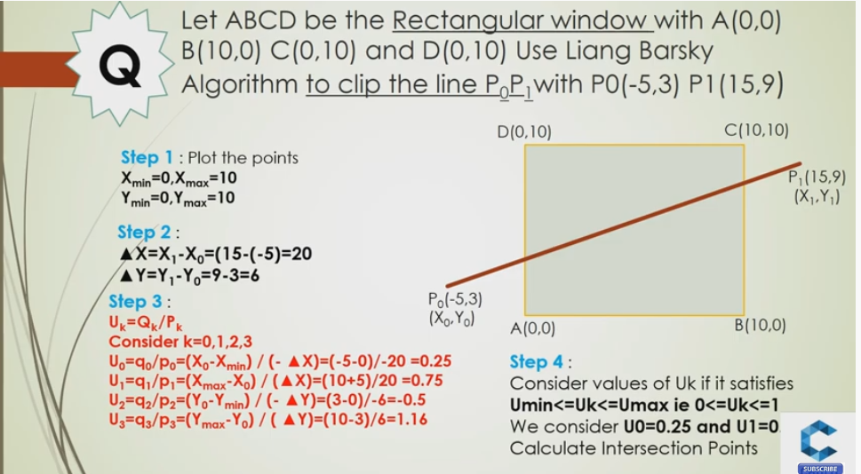
Example

Slide 12
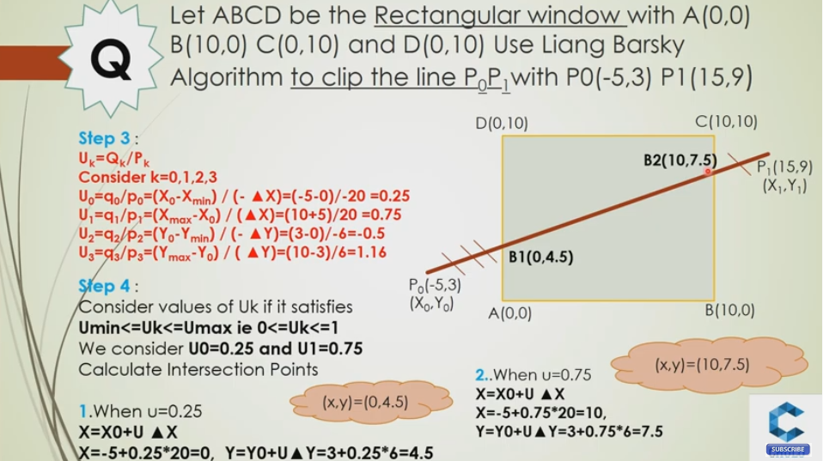
Example

Slide 13
Liang-Barsky Line Clipping
Cases:
  pk = 0
    Line is parallel to boundaries
      If for the same k, qk < 0, reject
      Else, accept
  pk < 0
    Line starts outside this boundary
      rk = qk / pk
      u1 = max(0, rk, u1)
  pk > 0
    Line starts inside this boundary
      rk = qk / pk
      u2 = min(1, rk, u2)
  If u1 > u2, the line is completely outside

Slide 14
Liang-Barsky Line Clipping
In most cases, Liang-Barsky is slightly more efficient
  Avoids multiple shortenings of line segments
However, Cohen-Sutherland is much easier to understand
  An important issue if you’re actually implementing

Slide 15
Nicholl-Lee-Nicholl
Line Clipping
This is a theoretically optimal clipping algorithm (at least in 2D)
  However, it only works well in 2D
More complicated than the others
Just do an overview here

Slide 16
Nicholl-Lee-Nicholl Line Clipping
Partition the region based on the first point (p1):
  Case 1: p1 inside region
  Case 2: p1 across edge
  Case 3: p1 across corner
Case 1
T
p1
L
R
B
p1
Case 2
LT
T
L
Case 3
T
TR
p1
L
LR
L
L
LB
TB
LB

Slide 17
Nicholl-Lee-Nicholl
Line Clipping
Can use symmetry to handle all other cases
“Algorithm” (really just a sketch):
  Find slopes of the line and the 4 region bounding lines
  Determine what region p2 is in
    If not in a labeled region, discard
    If in a labeled region, clip against the indicated sides

Slide 18
A Note on Redundancy
Why am I presenting multiple forms of clipping?
  Why do you learn multiple sorts?
    Fastest can be harder to understand / implement
    Best for the general case may not be for the specific case
      Bubble sort is really great on mostly sorted lists
    “History repeats itself”
      You may need to use a similar algorithm for something else; grab the closest match

Slide 19
Polygon Clipping
Polygons are just composed of lines. Why do we need to treat them differently?
  Need to keep track of what is inside
NOTE:
Lines
Polygons

Slide 20
Weiler-Atherton Polygon Clipping
When using Sutherland-Hodgeman, concavities can end up linked
A different clipping algorithm, the Weiler-Atherton algorithm, creates separate polygons
Remember
this?

Slide 21
Weiler-Atherton Polygon Clipping
Example:
Out -> In
Add clip vertex
Add end vertex
In -> Out
Add clip vertex
Cache old direction
Follow clip edge until
(a) new crossing found
(b) reach vertex already
added
In -> In
Add end vertex

Slide 22
Weiler-Atherton Polygon Clipping
Example (cont’d):
Continue from
cached vertex and
direction
Out -> In
Add clip vertex
Add end vertex
In -> Out
Add clip vertex
Cache old direction
Follow clip edge until
(a) new crossing found
(b) reach vertex already
added

Slide 23
Weiler-Atherton Polygon Clipping
Example (cont’d):
Final Result:
2 unconnected
polygons
Continue from
cached vertex and
direction
Nothing added
Finished

Slide 24
Weiler-Atherton Polygon Clipping
Difficulties:
  What if the polygon recrosses
  an edge?
  How big should your cache be?
  Geometry step must be able to create new polygons
    Not 1 in, 1 out

Slide 25
Done with Clipping
Point Clipping (really just culling)
  Easy, just do inequalities
Line Clipping
  Cohen-Sutherland
  Cyrus-Beck
  Liang-Barsky
  Nicholl-Lee-Nicholl
Polygon Clipping
  Sutherland-Hodgeman
  Weiler-Atherton
Any Questions?

